Slide 1
Predicting Commodities Prices and volumes
A Data-Mining Approach
Meiqing Zhang
Erin M. Ochoa
Rodrigo Valdes

Slide 2

GOal
Objective: predict prices and volumes of commodities
Factors:
Geophysical
Social
Economic

Slide 3



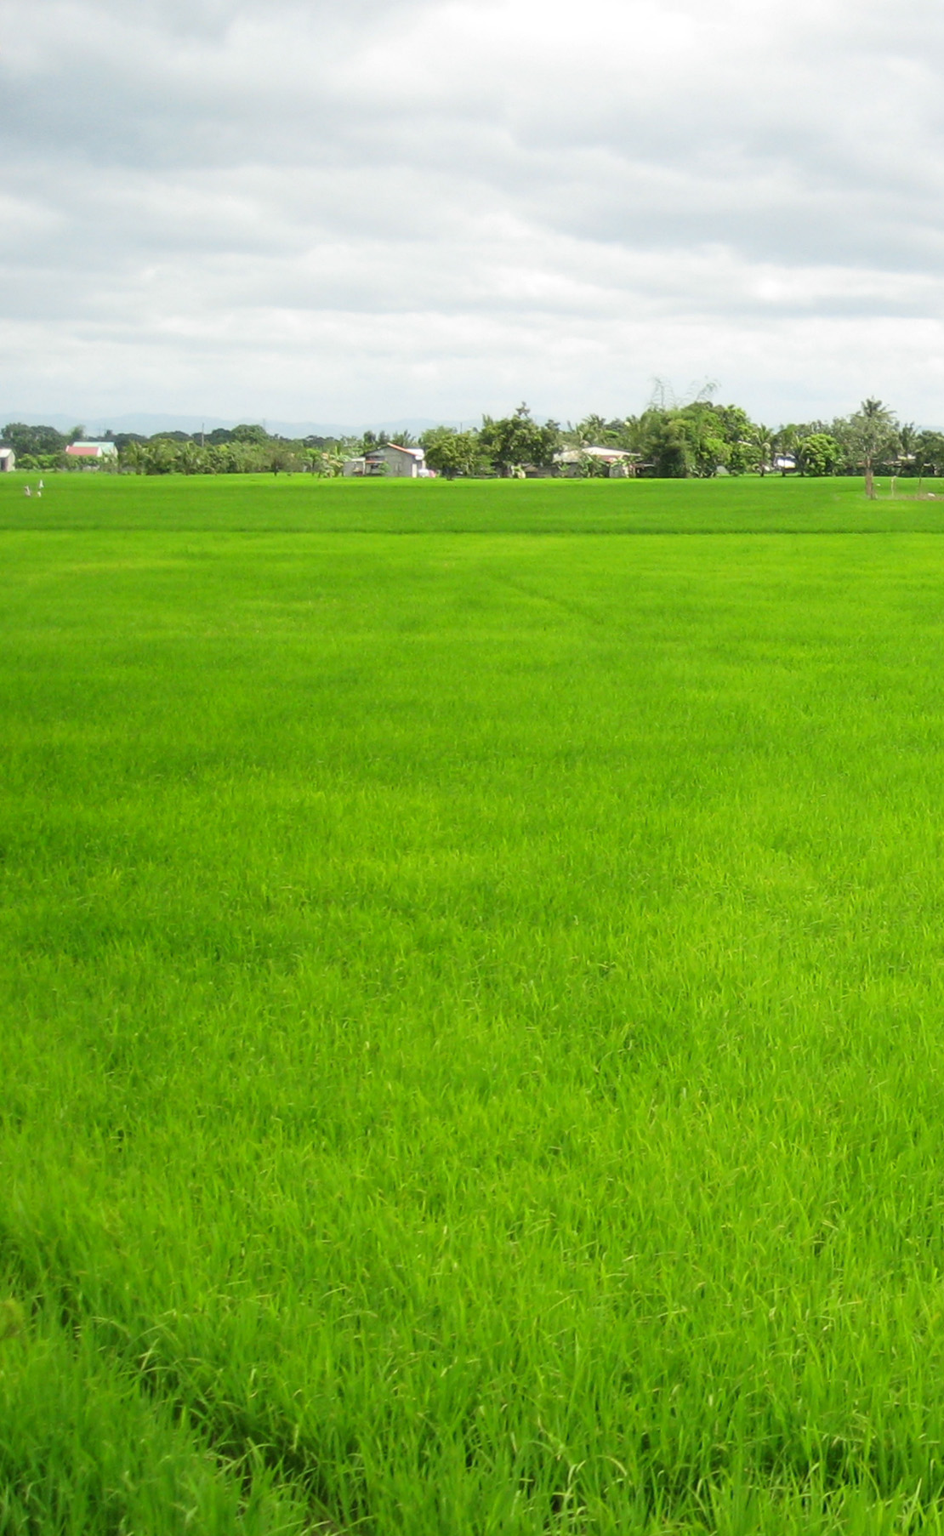


Factors

Slide 4






Methods and sources
Web scraping
Data cleaning
Data transformations
Forward selection
Principal component analysis
Prediction

Slide 5




Outputs

Slide 6


